Slide 1



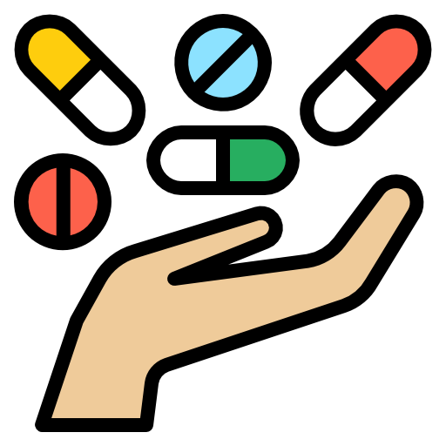


Medicine industry in Bangladesh

Slide 2
Our Group Members Are
Nusrat Mim | 2102010
Aishwariya Sarder | 2102012
MH Nazmul | 2102013
Sadia Homayra Nowshin | 2102014
Md Riadul Islam Mahi | 2102015
Md Mehedi Hasan | 2102016
Durjoy Das | 2102017
Jannatul Mim | 2102018

Slide 3
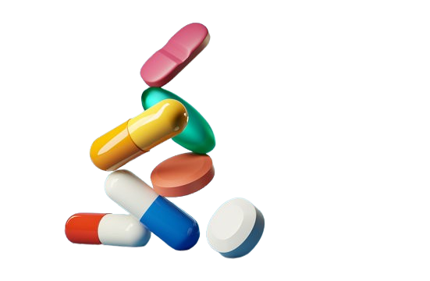
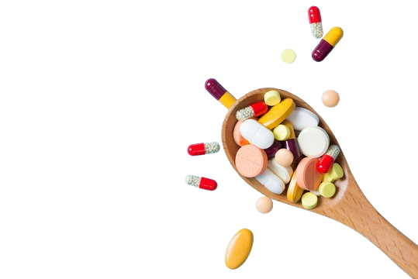
Medicine industry in Bangladesh has emerged as one of the technologically advanced sectors in country. Since the early 1980s, it has experienced substantial transformation and growth.
This sector provides 98% of the country’s demand for medicine. Manufactures produce almost all type of medicine including insulin, hormones, anti-cancer products etc. It exports medicines to over 150 countries.
In global medicine export market, Bangladesh competes with developed countries (India, China), aspiring to secure 10% of the exports market. The World Health Organization has recognized Bangladesh for its quality drug testing.
Introduction
Medicine industry in Bangladesh has emerged as one of the technologically advanced sectors in country.
Since the early 1980s, it has experienced substantial transformation and growth.
Pharmaceuticals company in Bangladesh.
Bangladesh has a self sufficient medicine industry.
Global recognition and competition .

Slide 4

Medicine industries in Bangladesh
Dependency and Awareness
People are now more health conscious than before. People are geeting dependent more on medicine.
Dependencies:
Natural causes :
Dieases
Accidents
Pendamic
Man made causes :
Less concious about heath
Taking heavy junk food or maintaining kito diet
unpunctuality
Awareness:
Taking healthy food
Leading punctual life
Cleanliness
Medicines are not supposed to be addictive. Take medicine based on needs.

Slide 7

GROWTH
Bangladesh's medicine industry is on a remarkable growth trajectory.
Grown from about 25 million dollar in 1982 to now about 4 billion dollar.
Serving 98 percent of domestic market.
Export more than 100 countries.
Forecasted to exceed 6 billion by 2025.
Why It is thriving?
People care more about health.
Government is backing the industry.
More money spent on healthcare.
Source: Daily Star, Bangladesh Investment Development Authority(BIDA),Wikipedia

Slide 8
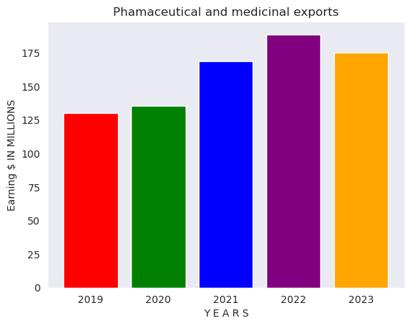

Bangladesh Exports: Medicinal and Pharmaceutical Product
Bangladesh exports most of its products in 21 countries in 2023.Among these countries Bangladesh was able to export more than $10 million worth of medicines to only four countries-- Sri Lanka, Myanmar, United States (USA) and the Philippines.

Slide 9


Challenges Overview
01
02
03
04
05
Quality Control and Assurance
Regulatory Challenges
Research and Development
Ensuring Product Safety
Counterfeit Drugs
Compliance Issues
Ever-Evolving Regulations
Funding Limitations
Talent Shortages
Sustainability and Environmental Concerns
Economic and Market Challenges
Waste Management
Environmental Impact
Inflation and Exchange Rates
Market Volatility

Slide 10
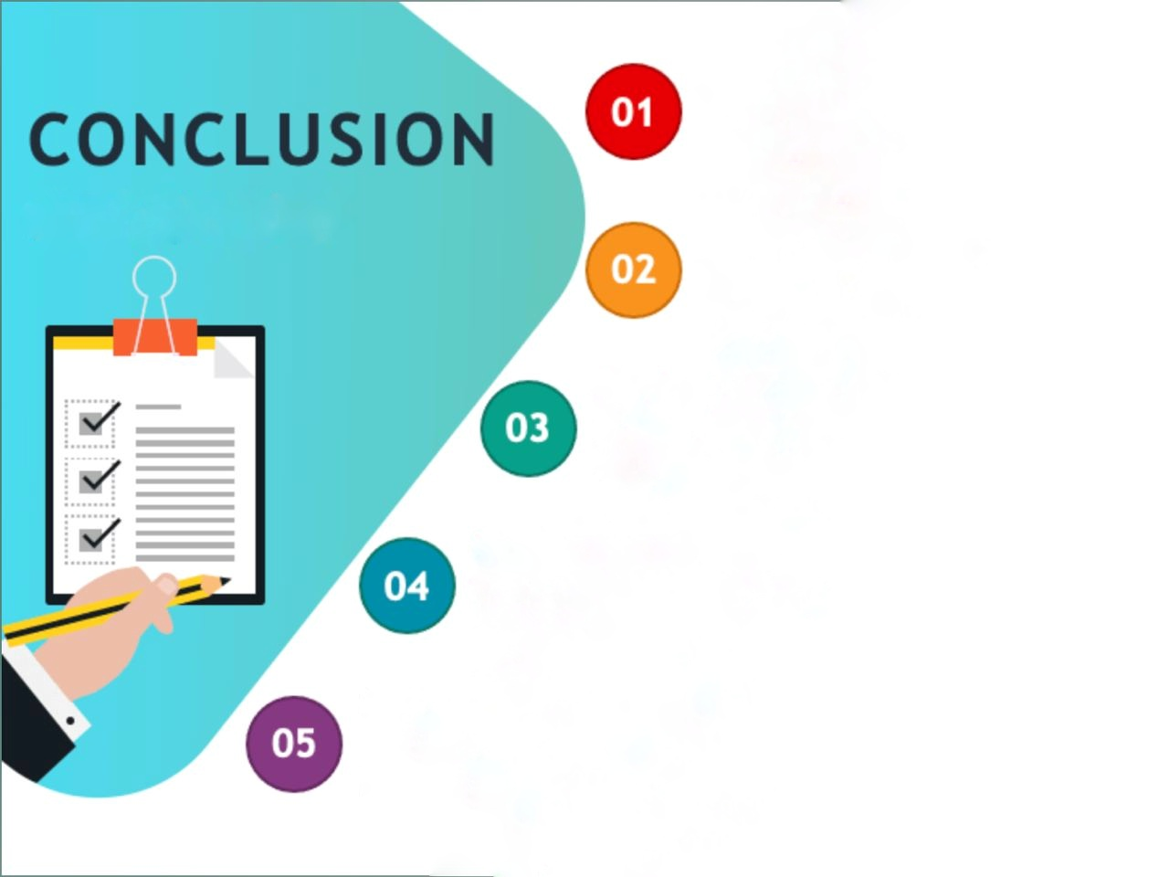
Generic Drug Manufacturing
Bangladesh has become a major player in the production of generic drugs
Export Growth
Madicine industry contribute not only the national economy but also golobal healthcare accesbility.
Research and Development (R&D)
The industry has been investing in research and development activities to create new drugs.
International Collaboration
Collaboration with international pharmaceutical companies, research institutions.
Contribution to the National Economy

Slide 11


